Slide 1
Shotley Point Yacht Club
AGENDA
1. Apologies for absence. (BdB)
2. Approval of the minutes. (BdB)
3. Annual report, Commodore. (MA) 3.1. Annual report, Vice Commodore. (GS)
4. Annual report from the Interim accounts and report from Hon Treasurer. To include annual fees. (RW) 4.1. Approval of auditor for the accounts.
5. Membership recruitment and retention. (SB)
6. Award presentations and recognitions. (MA)
7. Survey 2023. (GS)
8. Elections. 8.1 Officer step down. 8.2 Officers offering themselves for re-election. (BdB) 8.3 Committee Member standing down 8.4 Members offering themselves for re-election. (BdB) 8.5 Members offering themselves for election to Officer. 8.6 Members offering themselves for election to Committee.
9. Program for 2024. (GS) 9.1 Training (TB) 9.1 Summer Cruise 2023 (TB)
9.2 Summer Cruise 2024 (MA)
10. Any other business. (BdB)
11. Date of next AGM (BdB) .

Slide 2
Commodores Report Mark Abbott VR
Membership is stable
39 Events over 61 days, 6 Winter Workshops
Over 969M of cruising available, with 6590M sailed by our members.
20 different Skippers with 5 different Crew Pool over 46 Cruising Days.
Crow’s Nest is still a top read.
End of 3 Year Plan 90% achieved.
Our Committee keep the cogs moving!
Entrant for RYA Club of the year!

Slide 3
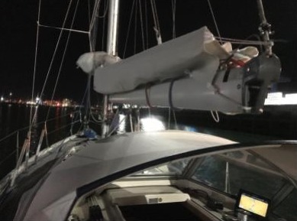
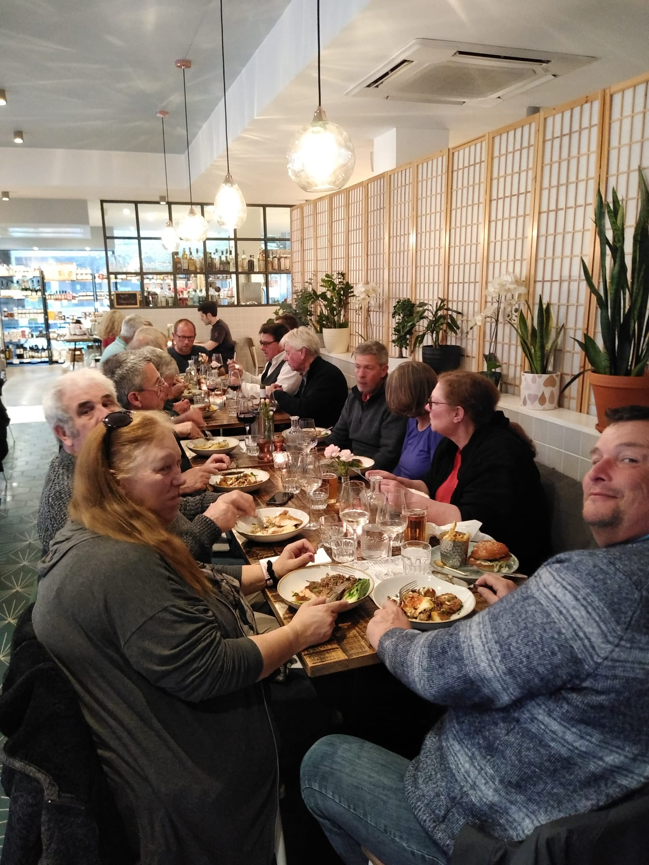
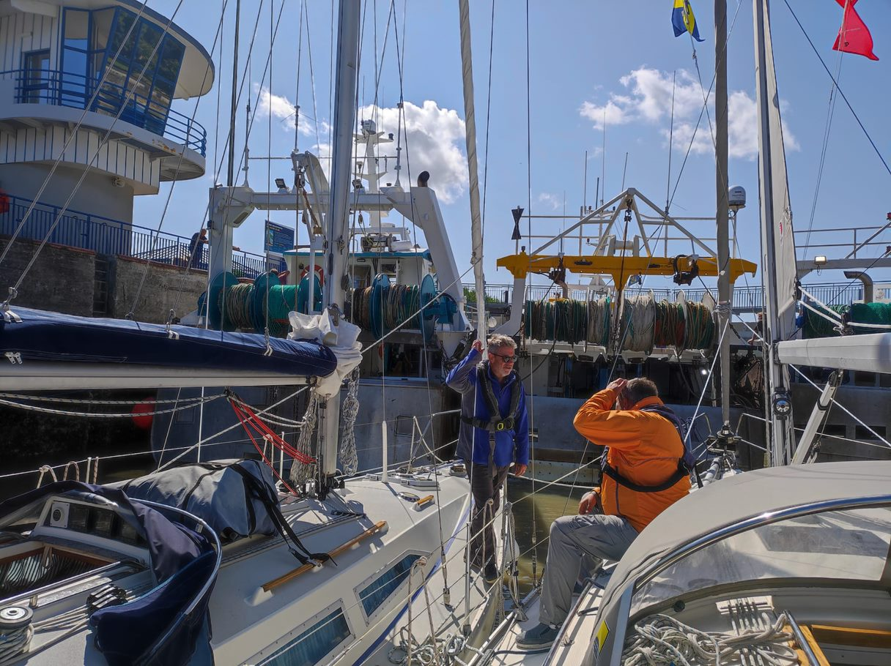
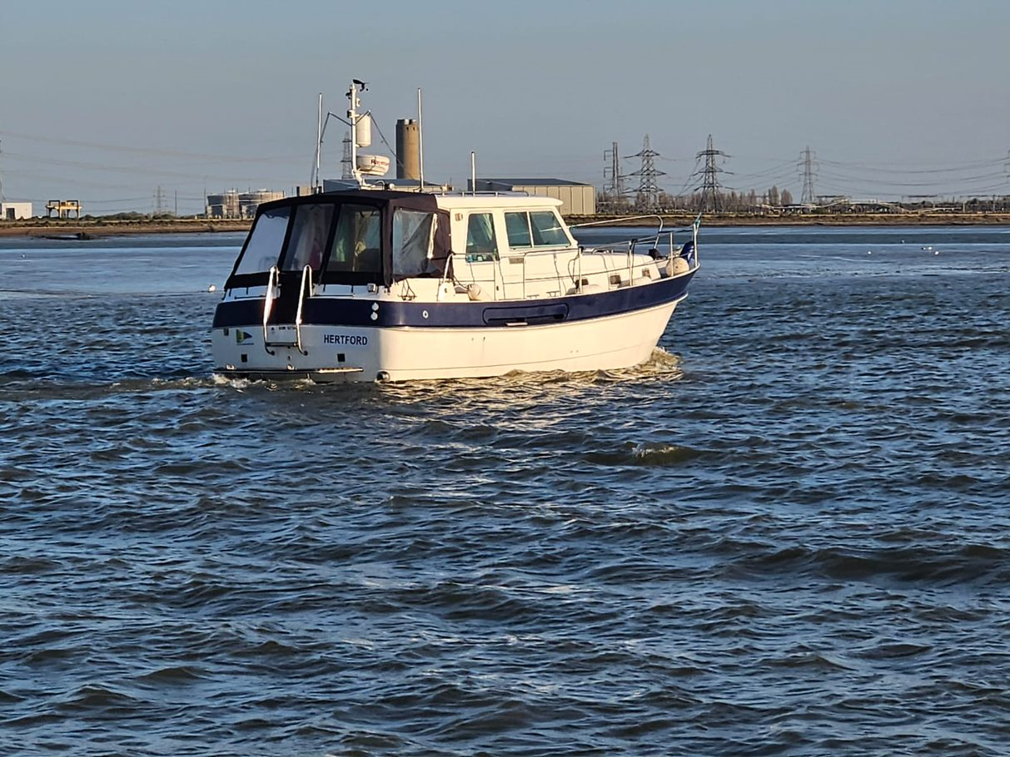
Vice-Commodore’s Report Garry Stratton
Highlights
Full programme of club events
Challenging first event of the season – Night Cruise to Ipswich
Something different in London
Ladies Day
Summer Cruise to France
Visit to Spirit Yachts!
Winter Workshops continue to be well attended and enjoyed
MOB with Duncan (and Tim!) invaluable
Crew Pool
Meet & Greet
Skippers and crew developing long term relationships

Slide 4
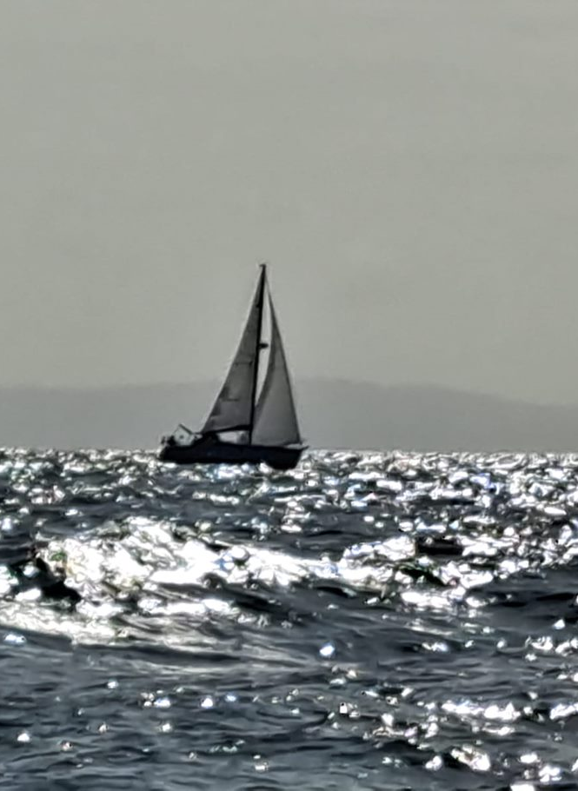
Vice-Commodore’s Report Garry Stratton
Looking Ahead
Trips are the lifeblood of our Club
Effective use of electronic and social media
Online event booking – don’t miss out!
Promote the value membership brings
MOB, tools and equipment…
Continue the integration of Crew Pool with events
Bring Boat owners and non-boat owners even closer together
Social events are highly valued
Could / should we do more?
If so, what do members want?
Engagement of all members
Especially new members

Slide 5
Hon Treasurers Richard White
 | PROFIT & LOSS 2023 |  |  | 2022 COMPARATIVES
 | 2023 |  |  | 2022
INCOME
Membership Fees | 3,900 |  |  | 4,010
Merchandise Sales (including charts) | 807 |  |  | 210
Bank Interest Received | 37 |  |  | 13
 |  | 4,743 |  |  | 4,233
EXPENSES
RYA Subs | 175 |  |  | 165
HASA Membership | 40 |  |  | 35
Website | 300 |  |  | 330
Insurance | 575 |  |  | 575
Purchase of tools and equipment | 1,327 |  |  | -
Office equipment & stationery | 144 |  |  | 158
Equipment for Training & Workshops | 370 |  |  | 972
Promotion & Advertising | 75 |  |  | 210
Cost of merchandise & burgees | 837 |  |  | 220
Hire of village hall | 328 |  |  | 280
Sundries | - |  |  | -
Events subsidies/drinks & nibbles | 158 |  |  | 263
AGM expenses | 25 |  |  | 175
Presentations & trophies | 0 |  |  | 40
 |  | 4,355 |  |  | 3,422
PROFIT/(LOSS) |  | 388 |  |  | 811

Slide 6
Hon Treasurers Richard White
 |  | BALANCE SHEET
 |  | 2023 |  |  | 2022
FIXED ASSETS
Equipment (all treated as expense in year occurred) |  | 0 |  |  | 0
CURRENT ASSETS
Stock | 845 |  |  | 897
Debtors & cheques to bank | - |  |  | -
Prepayments | 66 |  |  | 67
Bank accounts | 15,009 |  |  | 16,074
TOTAL ASSETS |  | 15,921 |  |  | 17,038
CURRENT LIABILITIES
Expenses not yet paid | 620 |  |  | 381
Babergh grant for school event | - |  |  | 500
Due to RNLI | 483 |  |  | 428
Pre paid subs | - |  |  | 1,300
 |  | 1,103 |  |  | 2,609
TOTAL ASSETS |  | 14,817 |  |  | 14,429
CAPITAL ACCOUNT
As at 1st January 2021 |  | 14,429 |  |  | 13,763
Net (loss)/profit |  | 388 |  |  | 666
 |  | 14,817 |  |  | 14,429

Slide 7
Membership Secretary Sheila Barnes
SPYC Membership Information 11 Nov 2023
Boat Members Renewed 45
Non Boat Owning Members Renewed 14
NEW Boat Owning Members 3
NEW Non-Boat Owning Members 4
Boat Owner ROLL-OVER from 2022 3
Honorary Members 2
Full Members NOT Renewed 13
Crew Pool NOT Renewed 9
TOTAL Membership 98
TOTAL Live Membership 76

Slide 8
Membership Secretary Sheila Barnes
Reasons for Non-Renewal
Full membership NOT Renewing;
Sold/Selling Boat 1
Moved Away 4
Passed Away 1
No Reason Given 7
Sub Total 13
Non-Boat Owners NOT Renewing;
Health 2
No Reason Given 7
Sub Total 9
The exact number of people is unclear, as new members do not necessarily give a second person when joining via website but 111 people are listed on database.

Slide 9
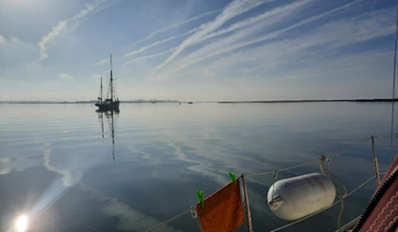
Awards Mark Abbott VR
Photographic Award
Kazarka
At anchor, Pyefleet Creek

Slide 10
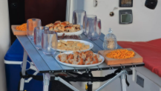
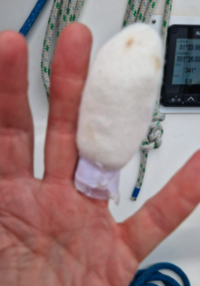
Awards Mark Abbott VR
Eberhardt Cup
awarded for the biggest contribution to hosting.
Ian, Parish ^{(for hosting at Brightlingsea)}
Endeavour Award
awarded for outstanding endeavour.
David Brief ^{(for blowing up an} ^{oven after falling on}
It and towing a trawler with his finger)

Slide 11
Awards Mark Abbott VR
Commodore’s Cup awarded for the most sea miles achieved on Club events.
1st Place Nigel Baker Malahi 841M
2nd Place Paul Rowden Porschia 689.5M
3rd Place Peter Morley Aquila 658M

Slide 12
Shotley Point Yacht Club
AGENDA
1. Apologies for absence. (BdB)
2. Approval of the minutes. (BdB)
3. Annual report, Commodore. (MA) 3.1. Annual report, Vice Commodore. (GS)
4. Annual report from the Interim accounts and report from Hon Treasurer. To include annual fees. (RW) 4.1. Approval of auditor for the accounts.
5. Membership recruitment and retention. (SB)
6. Award presentations and recognitions. (MA)
7. Survey 2023. (GS)
8. Elections. 8.1 Officer step down. 8.2 Officers offering themselves for re-election. (BdB) 8.3 Committee Member standing down 8.4 Members offering themselves for re-election. (BdB) 8.5 Members offering themselves for election to Officer. 8.6 Members offering themselves for election to Committee.
9. Program for 2024. (GS) 9.1 Training (TB) 9.1 Summer Cruise 2023 (TB)
9.2 Summer Cruise 2024 (MA)
10. Any other business. (BdB)
11. Date of next AGM (BdB) .
Time For a Cupper,
Back in 10min

Slide 13
Membership Survey 2023 Garry Stratton
Oh No!
Not another survey!!
Surveys are hugely valuable… (or the results are!)
Your committee needs to know whether they’re steering the right course
Is the club delivering according to its aims and members’ expectations?
What do we need in order to grow the club in a way that will sustain it for the future?
But you can have too much of a good thing!
No survey this year

Slide 14
Membership Survey 2023 Garry Stratton
Oh No!
Not another survey!!
Data and information from three years of surveys
We asked:
Why did you join Shotley Point Yacht Club?
If you haven't joined any Club activities this year, why?
Does the Club provide what you're looking for?
What is the best thing about the Club?
What is the worst thing about the Club?
What single change would improve your membership experience?
These are still the key questions…

Slide 15
Membership Survey 2023 Garry Stratton
Oh No!
Not another survey!!
What have we learned?
Social Activities
Clubhouse
Communication & Marketing
Online Community
Crewing Opportunities
Participation in Events

Slide 16
Membership Survey 2023 Garry Stratton
Oh No!
Not another survey!!
What have we done… and what should we do?
Main Themes | What have we done? | What should we do?
People want more social activities | Four scheduled, but unfortunately Home Port Weekend cancelled this year | More ad hoc Friday night get togethers? Identify hosts? Meet and Greet for new members (and buddy system?)
Better online community | WhatsApp, Facebook | More use of forums on the website?
Many people would like a clubhouse | This would make us a different type of club and is not thought to be feasible | Look at other opportunities, eg adopt a pub?!
Relatively low proportion of members join in events due to availability | Tried midweek cruises in the past with little success | Has membership changed, so try again?
More crewing opportunities | Meet and Greet Club Sailing Days | Continue
Communication and marketing of events | Events booking self-service, WhatsApp, newsletters | Increase visibility of upcoming events
(Continue to) watch this space… and let us have your ideas

Slide 17
Membership Survey 2023 Garry Stratton
Oh No!
Not another survey!!
Questions?

Slide 18
Election of Committee 2024 Barbara de Bruine
9.1 Officers Stepping down – Commodore; Mark Abbott
Vice Commodore; Garry Stratton
Secretary; Barbara de Bruine
9.2 Officer offering themselves for re-election – Treasurer; Richard White
9.3 Committee members stepping down- Crow’s Nest; Mark Taylor
9.4 Committee members offering themselves for re-election – Sheila Barnes, Tim Bultitude,
Nigel Baker

Slide 19
Election of Committee 2024 Barbara de Bruine
9.5 Committee members offering themselves for election to Officers – Commodore; Stuart Robinson,
Vice Commodore; Helen Baker
Secretary; Sue Armstrong
9.6 Members offering themselves for election to Committee – Crow’s Nest; Sarah Howie
Room for 4 more committee members

Slide 20
Events 2024 Garry Statton
Full programme planned for 2024
Winter Workshops - practical & theory
Cruising Events – Far and wide!
Club Sailing Days
Social Programme – Meet and greet New members and Crewpool
Something for everyone!

Slide 21
Events 2024 Garry Stratton
Cruising Events
10 trips
Old favourites and a new destination on the Thames
Netherlands, Summer Cruise
Constrained by weather, but we have some great destinations and sailing / cruising / navigation challenges!
Ideas for trips are always welcome
New hosts are very welcome – give it a try!!
There’s always someone to help

Slide 22
Events 2024 Garry Stratton
Club Sailing Days
Saturday 13 April
Saturday 25 May
Saturday 8 June
Sunday 11 August
Saturday 14 September
Saturday 19 October
Short, social trips
Opportunities to cruise in company
Try some navigation techniques
Invite non-boat owners
Experience for Crew Pool

Slide 23
Events 2024 Garry Stratton
Social Events
2 March Meet and Greet
16 March Fitting Out Supper
2 June RHYC Lunch
14 Sep Home Port Day
26 October Laying up Supper
14 December AGM and Christmas party

Slide 24
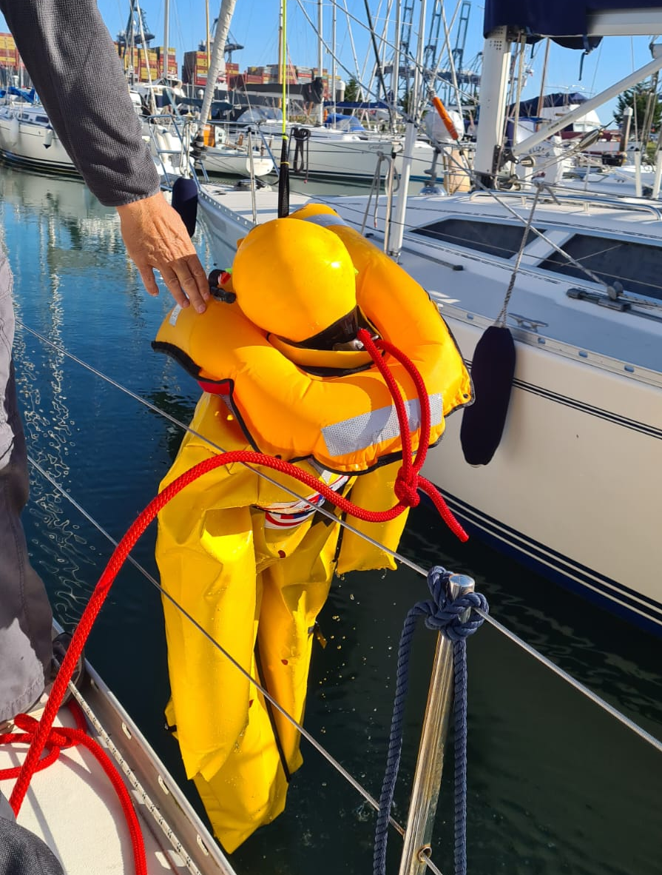
Events 2024 Tim Bultitude
Skills
13 January Basic Boat Electrics
10 February Passage Plan to Europe, Customs
9 March Winch Servicing – a practical session
5 October Splicing Modern Ropes
19 November Lifejacket Servicing
7 December Lights, Shapes & Colregs
Winter Workshops
Plus
14 April
4 May
9 June
Man Overboard: practical with Duncan

Slide 25
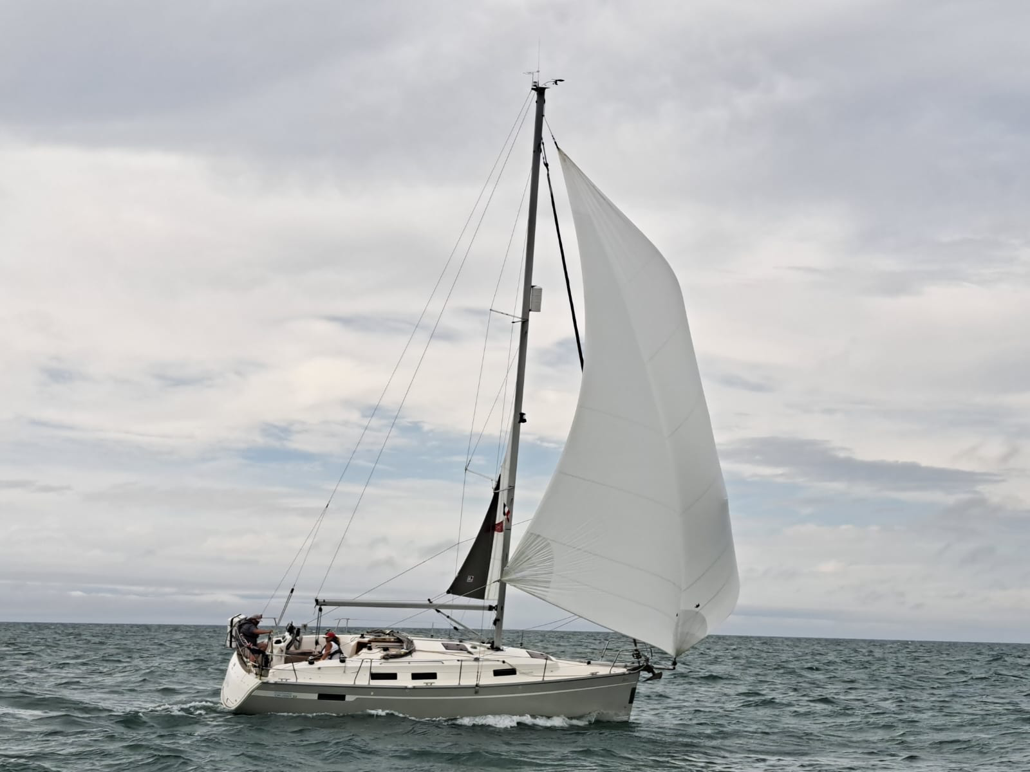
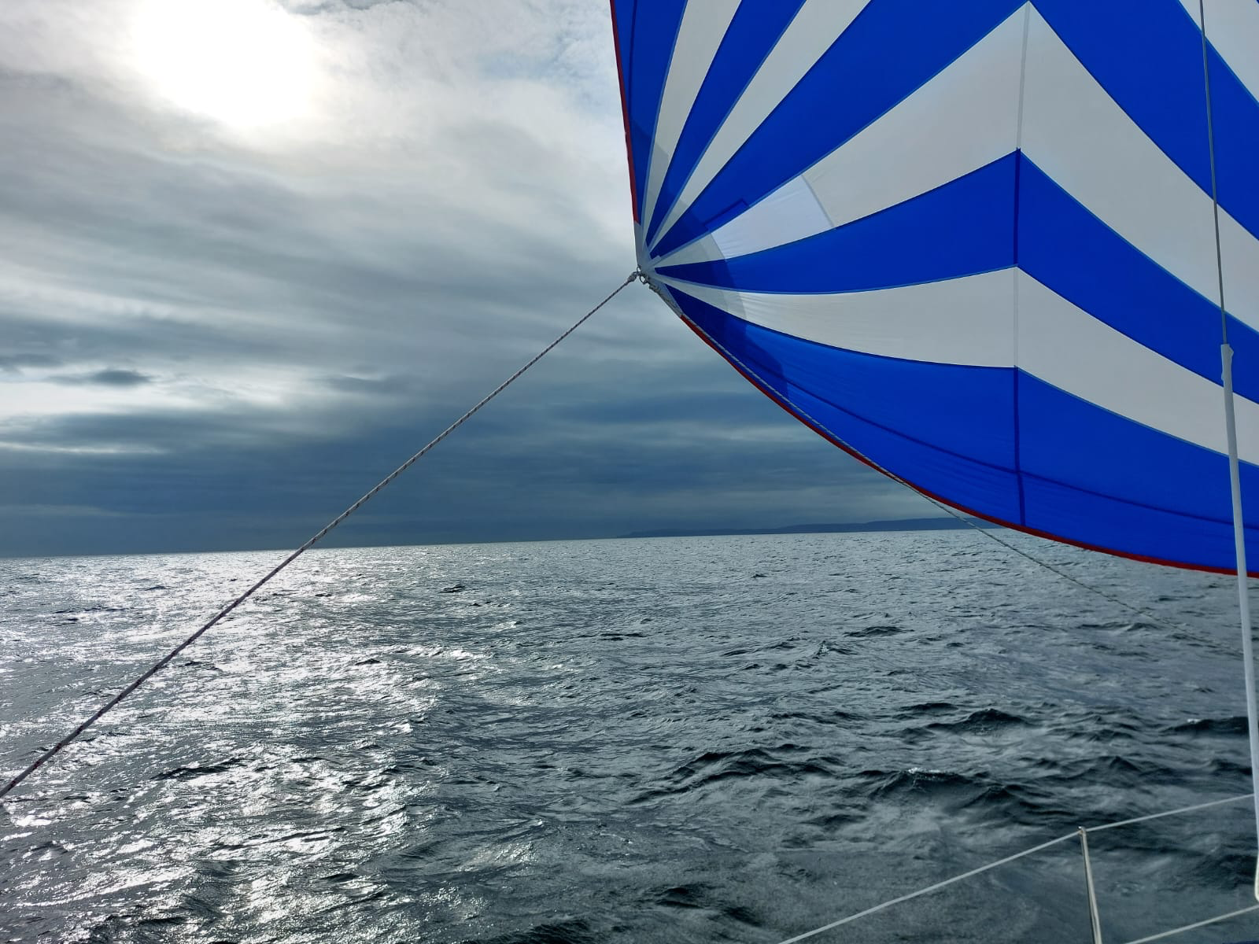
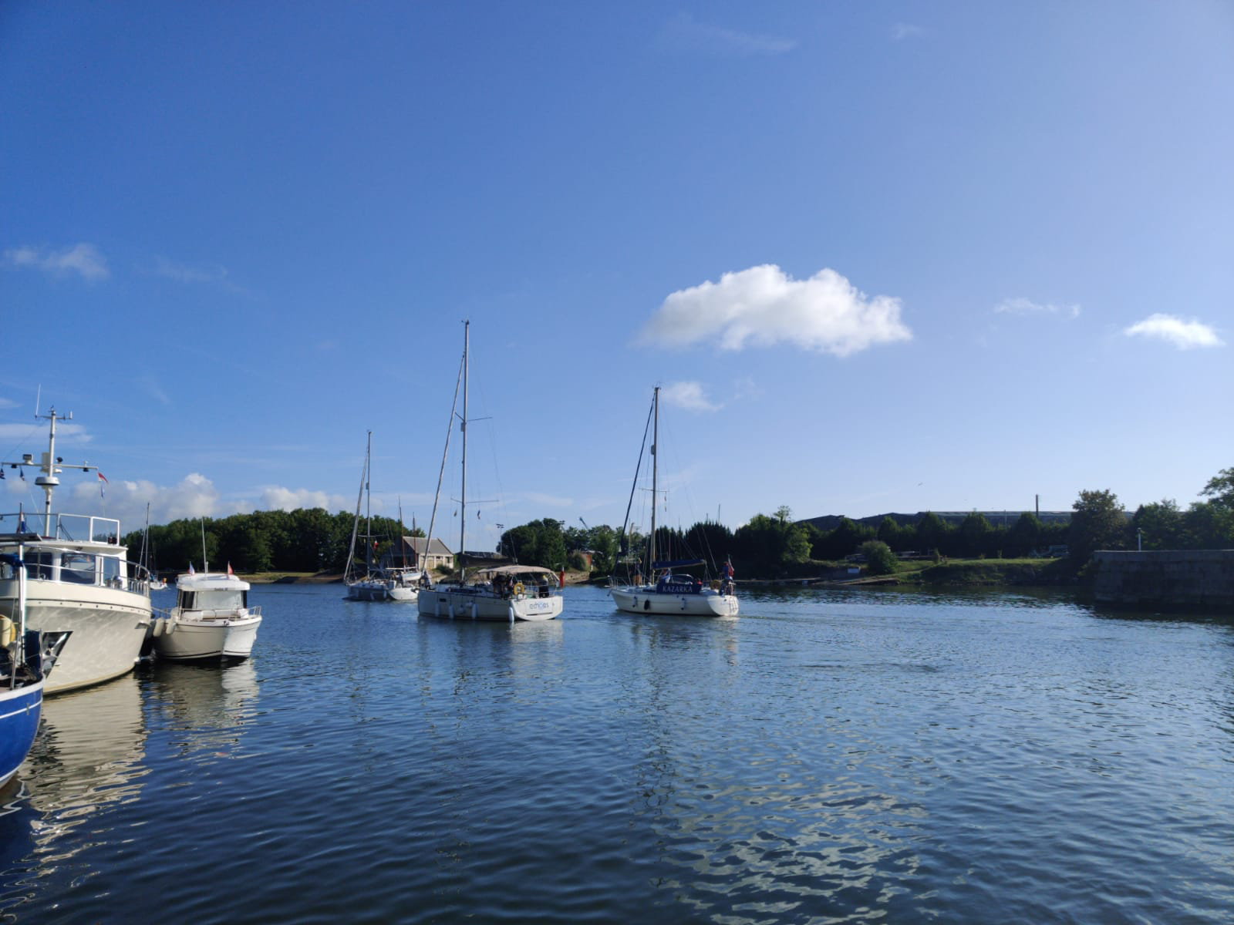
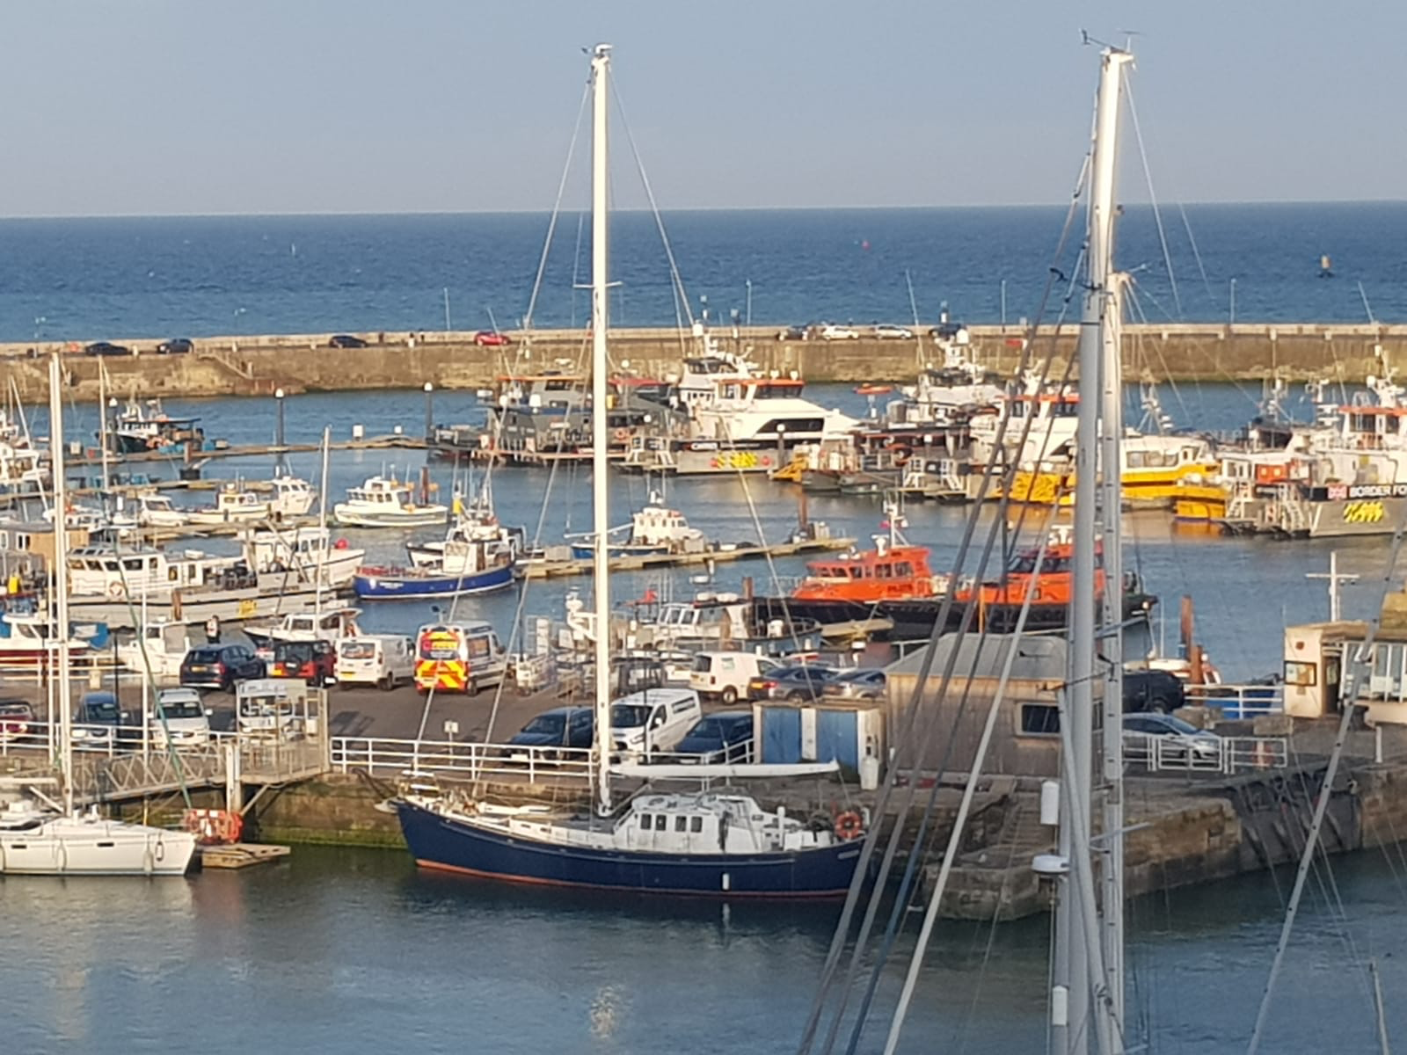
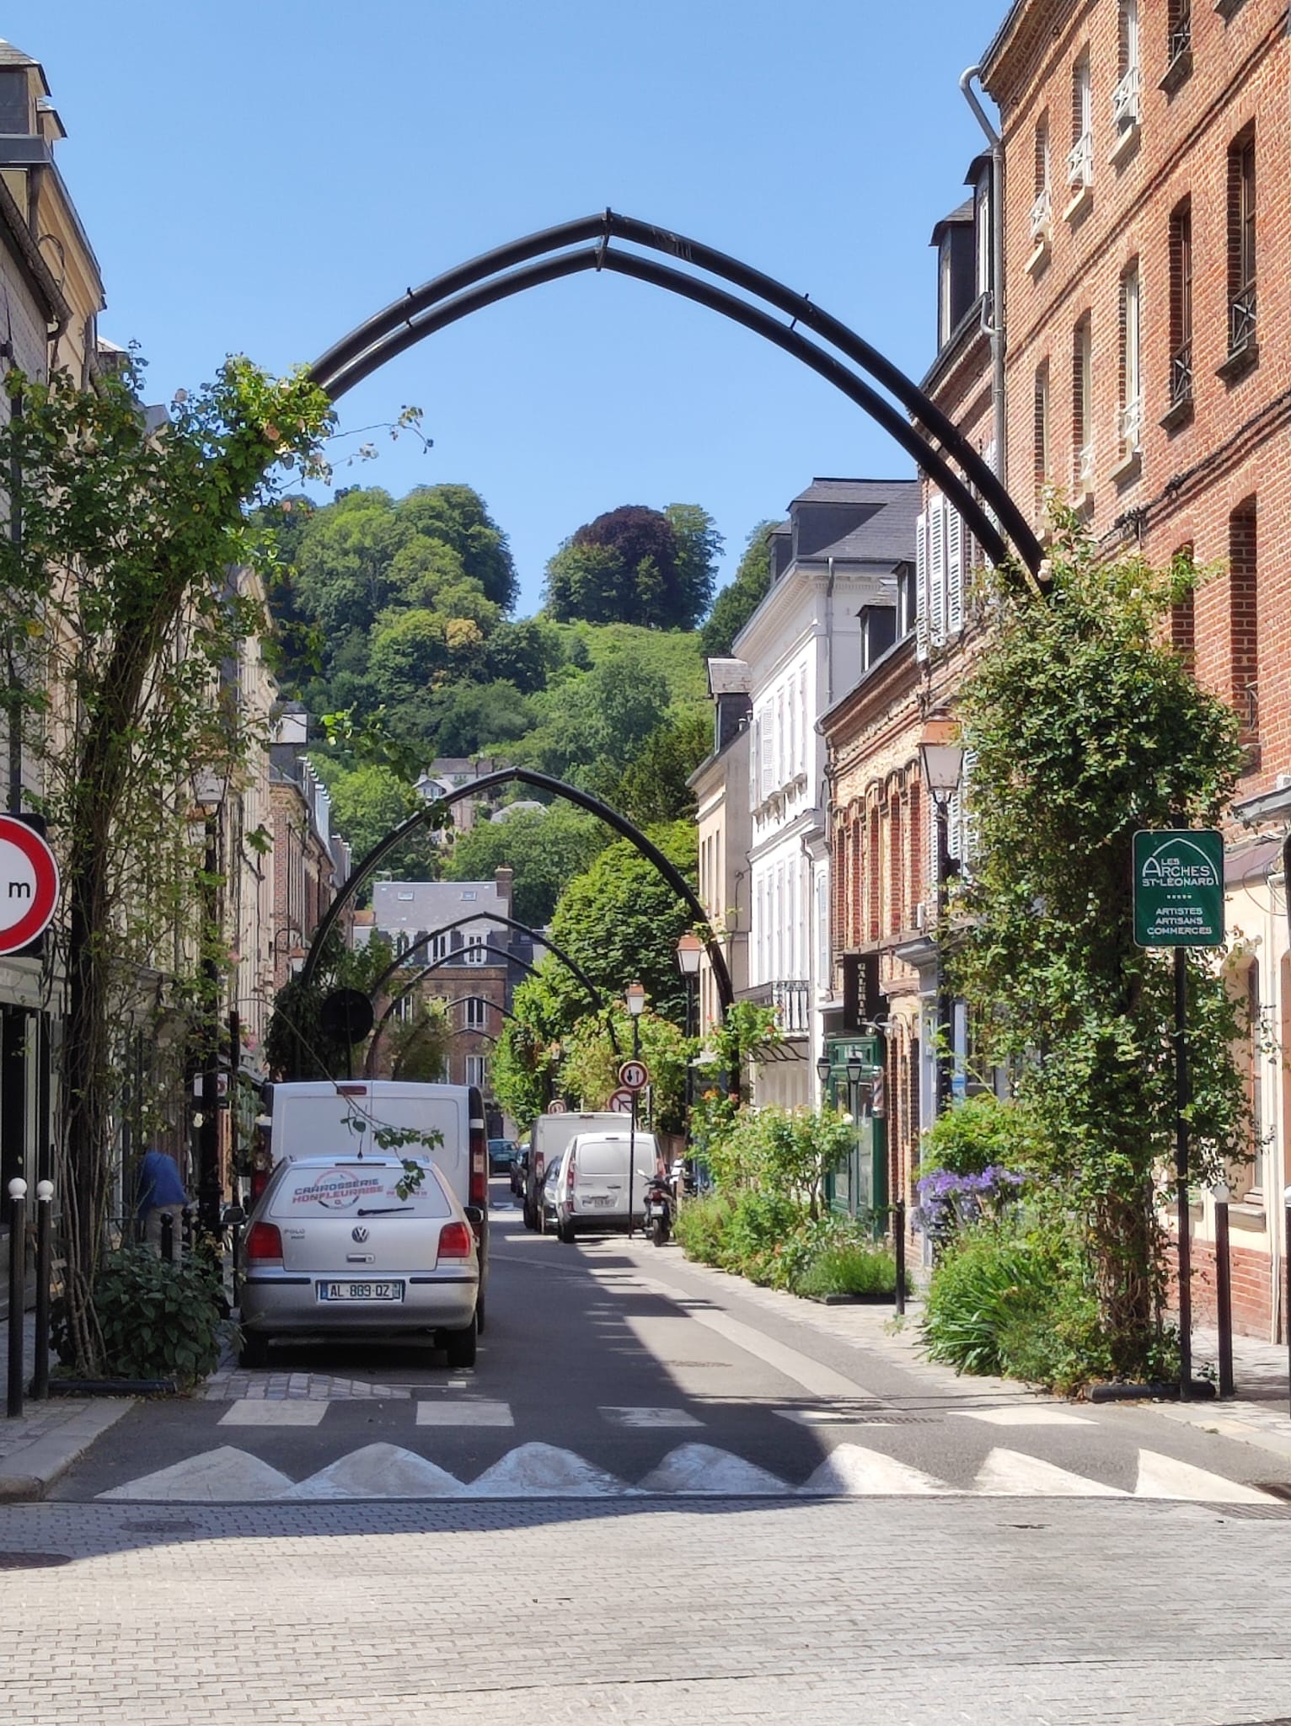
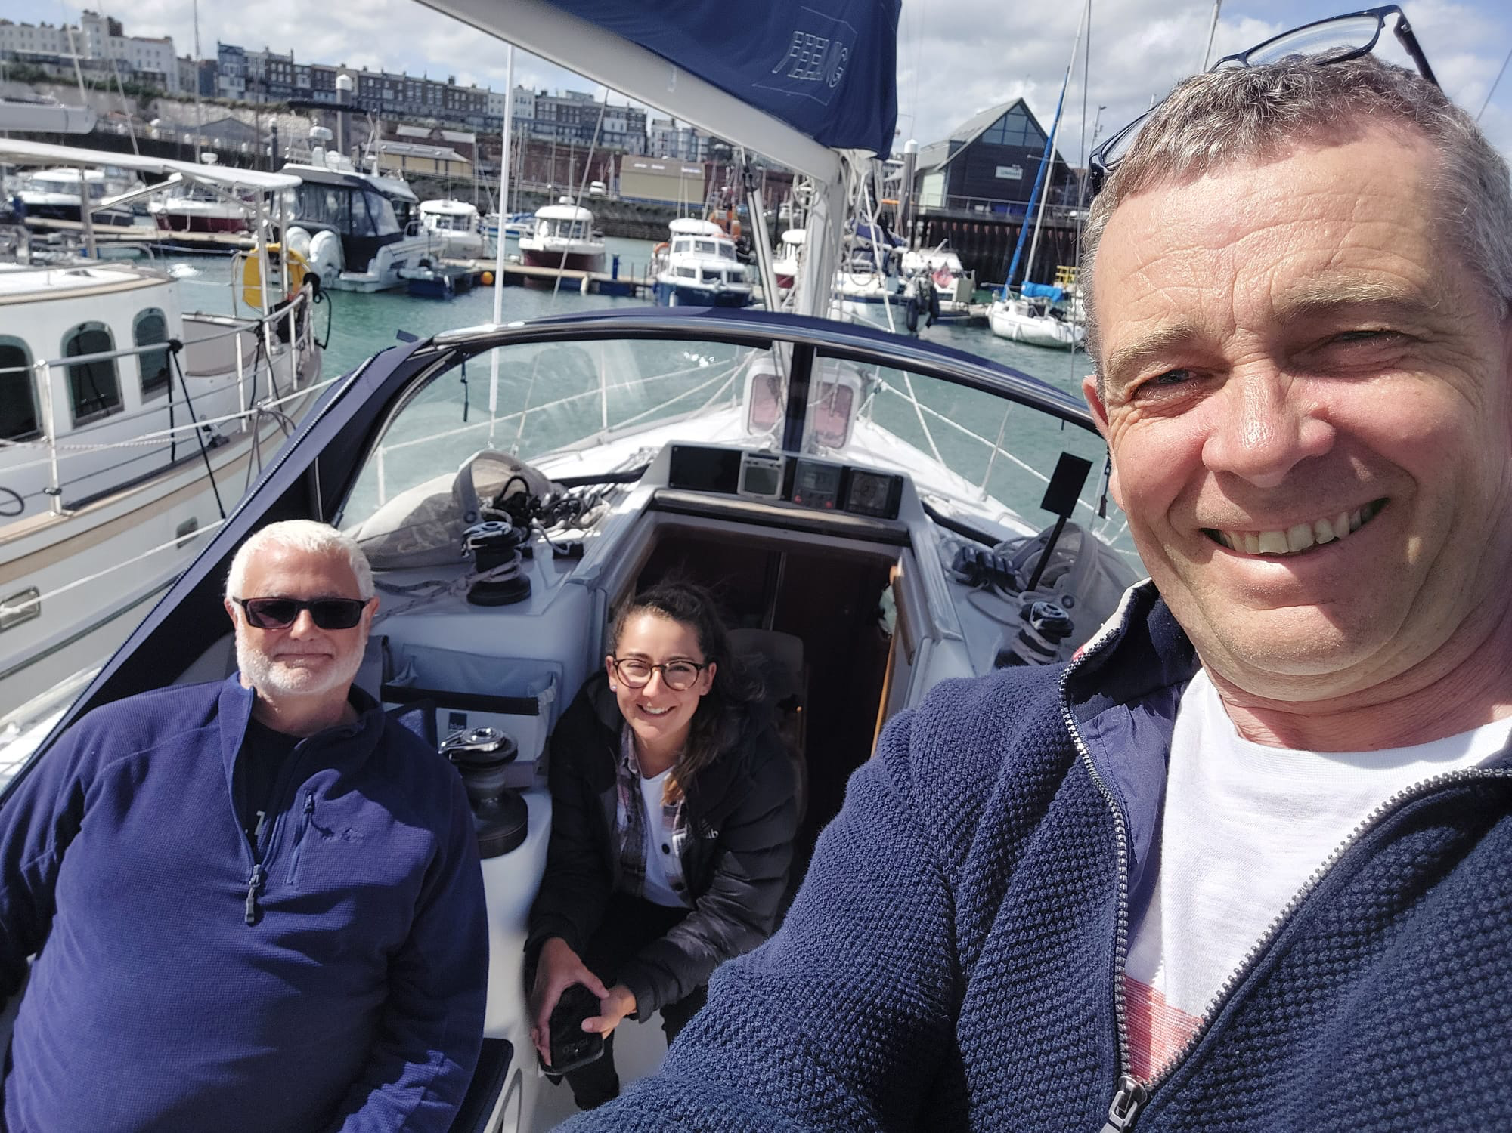
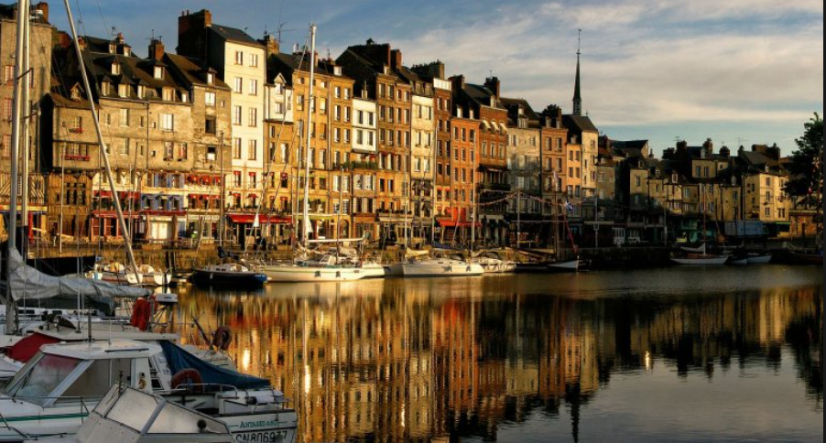
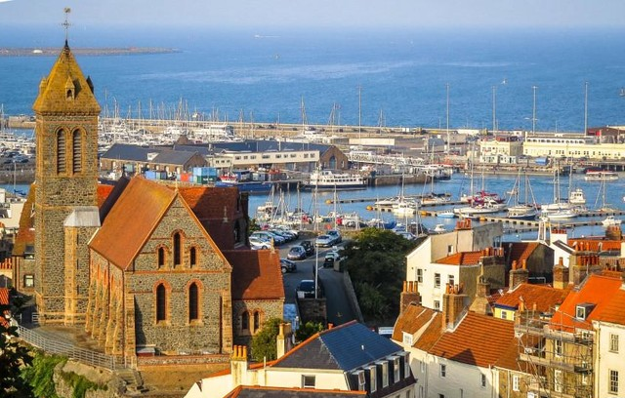
Summer Cruise 2023 Tim Bultitude & Pete Morley

Slide 26
Summer Cruise 2023 Tim Bultitude & Pete Morley
What we learnt- Expect the weather to fight against you!
Our members are not ocean fit and need a rest after an arduous days sailing.
Think for yourself, it’s not the job of the organizer to plan your every move.
The ability to shuffle crew around on long legs.
The comfort of having friends close by when you knock yourself out with the boom block, or chop your figure off.
Week 1
Week 2
ACTUAL
Return

Slide 27
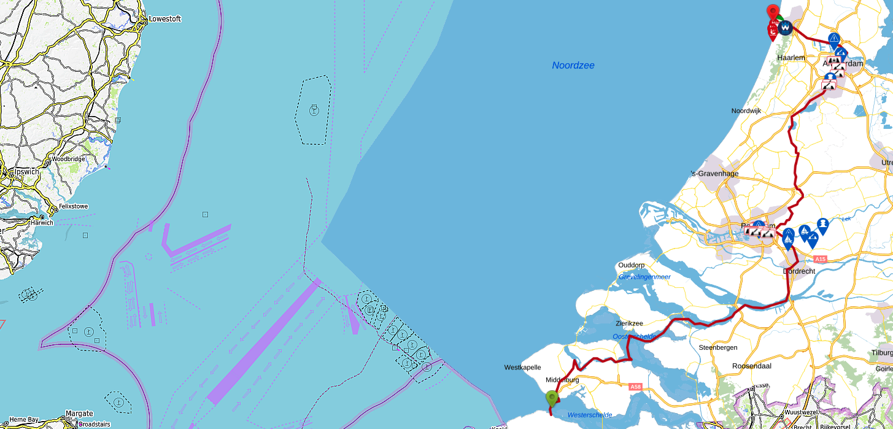
Summer Cruise 2024 Mark Abbott
Plan-
Leave Shotley Sat 22nd June
Arrive Breskins Sun 23rd
Breskins – Middelburg, Mon 24th
Day off, Tue 25th
Middelburg - Goes Wed 26th
Goes - Bruisse Thu 27th
Day off, Fri 28th
Bruisse - Willemstad Sat 29th
Willemstad – Gouda Sun 30th
Day off, Mon 1st
Gouda – Niewe Meer Tue 2nd
Niewe Meer – Amsterdam Marina (Night Convoy) Wed 3rd
Day off, Thu 4th
Amsterdam Marina – Ijmuiden Seaport Fri 5th
Leave Ijmuiden Seaport Sat 6th
Arrive Shotley Sun 7th
Facts-
125M, 27 bridges, 4 locks on the inland waterways
222M crossing there & back
Total 347M
Pre-Meetings
March 3rd
May 26th

Slide 28
AGM 2023 Stuart Robinson
AOB
Questions?
Next AGM Saturday 14th December 2024

Slide 29
Shotley Point Yacht Club
AGENDA
1. Apologies for absence. (BdB)
2. Approval of the minutes. (BdB)
3. Annual report, Commodore. (MA) 3.1. Annual report, Vice Commodore. (GS)
4. Annual report from the Interim accounts and report from Hon Treasurer. To include annual fees. (RW) 4.1. Approval of auditor for the accounts.
5. Membership recruitment and retention. (SB)
6. Award presentations and recognitions. (MA)
7. Survey 2023. (GS)
8. Elections. 8.1 Officer step down. 8.2 Officers offering themselves for re-election. (BdB) 8.3 Committee Member standing down 8.4 Members offering themselves for re-election. (BdB) 8.5 Members offering themselves for election to Officer. 8.6 Members offering themselves for election to Committee.
9. Program for 2024. (GS) 9.1 Training (TB) 9.1 Summer Cruise 2023 (TB)
9.2 Summer Cruise 2024 (MA)
10. Any other business. (BdB)
11. Date of next AGM (BdB) .
Thank You all for your continued Support!

