Slide 1
Shotley Point Yacht Club
AGENDA
1. Apologies for absence. (BdB)
2. Approval of the minutes. (BdB)
3. Annual report, Commodore. (MA) 3.1. Annual report, Vice Commodore. (SR)
4. Annual report from the Interim accounts and report from Hon Treasurer. To include annual fees. (RW) 4.1. Approval of auditor for the accounts.
5. Membership recruitment and retention. (SB)
6. Award presentations and recognitions. (MA)
7. Changes to Constitution and Code of Practice. (MA)
8. Survey 2022. (GS)
9. Elections. 9.1 Officer step down. 9.2 Officers offering themselves for re-election. (BdB) 9.3 Committee Member standing down 9.4 Members offering themselves for re-election. (BdB) 9.5 Members offering themselves for election to Officer. 9.6 Members offering themselves for election to Committee.
10. Program for 2023. (GS) 11.1 Summer Cruise (TB,PM)
11. Any other business. (BdB)
12. Date of next AGM (BdB) .

Slide 2
Commodores Report Mark Abbott VR
Membership is stable
35 Events over 61 days, with over 657M of cruising available.
10 different Skippers with 18 different Crew Pool over 7 Cruising Days.
10 Winter Workshops
IT- Club Website, still one of the best platforms in the yachting community. WhatsApp, continuing to prove itself invaluable for communication on events with between 30,50% take up. Facebook outward facing vibrant post with local retailers piggybacking of our reach. Outside of the professional yachting supplements, the Crow’s Nest stands head and shoulders above anything out there.
Improved process between Constitution and Code of Practice.
Mid way through 3 Year Plan 80% achieved.
Our Committee keep the cogs moving

Slide 3
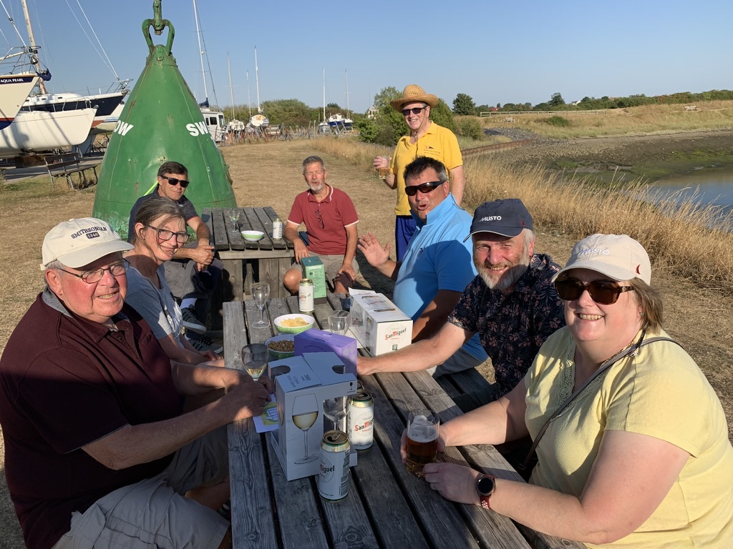
Vice-Commodores Report Stuart Robinson
Successful programme of club events completed in 2022
Training Days - thanks to Tim B. MOB sessions a particular success
Cruising Events & Crew Pool - a growing synergy
Superb social atmosphere

Slide 4
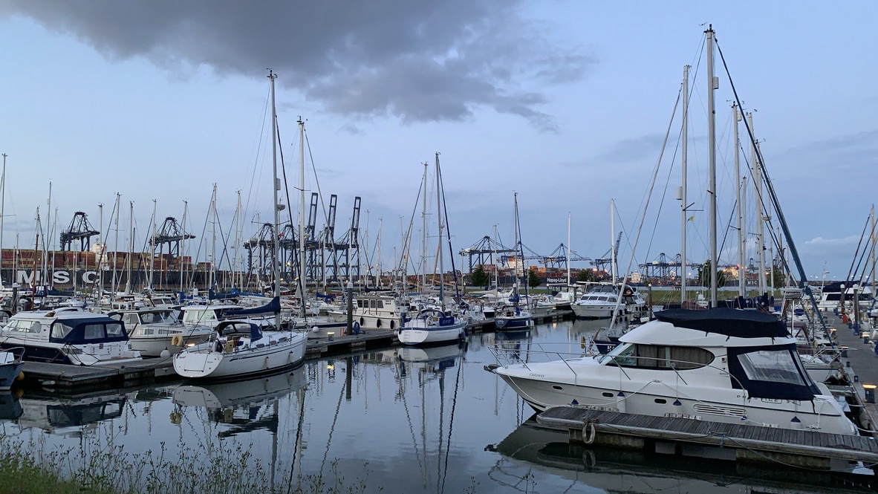
Vice-Commodores Report Stuart Robinson
Challenges for 2023
Increasing tendency of marinas not to accept provisional bookings
Some venues requesting prior non-refundable payment

Slide 5
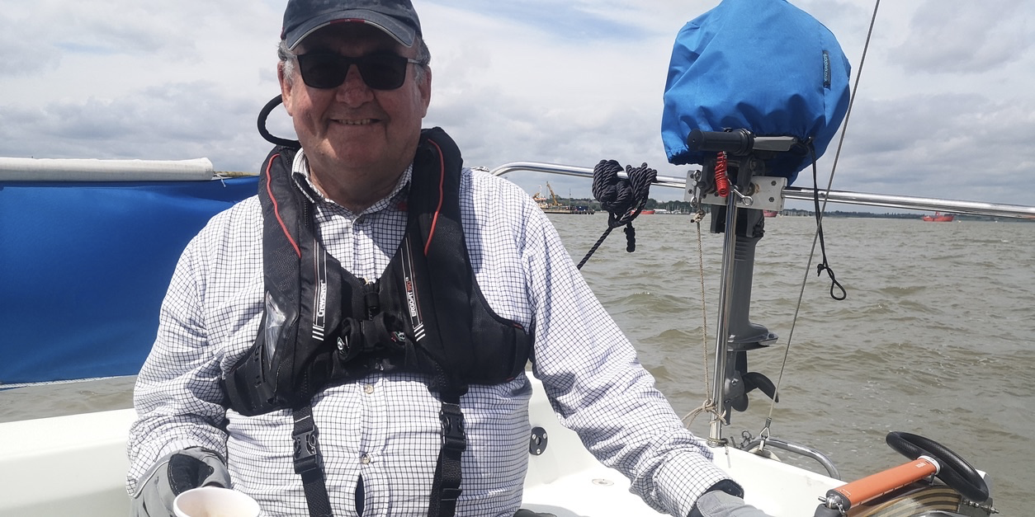
Vice-Commodores Report Stuart Robinson
SR standing down as VC for 2023
Remaining as Committee member
Grateful thanks to Mark A and the committee for their support in what has been a difficult 2022 for me

Slide 6
Hon Treasurers Richard White
Main Financial Point 2022
Income Increased by £176 over 2021(not including
trailer sale £1,995)
Expenditure £526 below 2021
Excess Income to Expenditure 2022 £892
Bank balance has increased every year since 2020
(Currently £17,428)

Slide 7
Hon Treasurers Richard White
Interim Accounts For The Year Ending 31.12.2022 Produced 21.11.2022
Income 2022 2021
Membership Fees 4,010 3,667
Merchandise Sales 210 381
Grant From RYA for Training - -
Grant form Sports England - -
Profit on Sale of Trailer 0 1,463
Bank Interest Received 5 1
4,225 5,512
Expenses
RYA Subs 165 155
HASA Membership 35 -
Website 285 983
Zoom Pro License 145 144
Insurance 575 569
Purchase of tools &
Children's Lifejackets 0 425
Office Equipment & Stationery 158 47
Expenses Continued 2022 2021
Equipment for Training 845 289
Promotion & Advertising 210 76
Merchandise & Burgees 221 448
Hire of Village Hall 280 -
Calendars - 235
Sundries - 30
Event Sub/drinks & Nibbles 263 247
AGM expenses 175 43
Presentations & Trophies - -
Depreciation of assets - 230
3,356 3,992
Profit/(Loss) 869 1,590
Charitable donations raised by members:
RNLI – donated during 2022&2023 £38 £390

Slide 8
Hon Treasurers Richard White
Balance Sheet
2022 2021
Fixed Assets
Equipment* 0 0
Current Assets
Stock 836 1,056
Debtors & Cheques to Bank - -
Prepayments 66 66
Bank Account 17,428 13,899
Total Assets 18,330 15,021
2022 2021
Current Liabilities
Expenses not yet paid 2,444 -
Babergh School Grant 500 500
Due to RNLI 428 390
Pre Paid Subs 208 368
3,580 1,258
Total Assets 14,750 13,763
Capital Account
As at the 1.1.2021 13,763 12,173
Net (loss) Profit 869 1,590
14,632 13,763

Slide 9
Membership Secretary Sheila Barnes
SPYC Membership Information 11Nov 2022
Boat Members Renewed 42
Non Boat Owning Members Renewed 14
NEW Boat Owning Members 11
NEW Non-Boat Owning Members 4
Boat Owner ROLL-OVER from 2021 5
Non-Boat Ownings ROLL-OVER 2021 4
Honorary Members 2
Full Members NOT Renewed 15
Crew Pool NOT Renewed 13
TOTAL Membership 110
TOTAL Live Membership 82

Slide 10
Membership Secretary Sheila Barnes
Reasons for Non-Renewal
Full membership NOT Renewing;
Sold/Selling Boat 2
Not Getting Value 1
Half of Couple Now Owners 1
Not Joining in Events/Work 2
No Reason Given 9
Sub Total 15
Non-Boat Owners NOT Renewing;
Moved Away 2
Sailing Overseas 1
No Reason Given 10
Sub Total 13
The exact number of people is unclear, as new members do not necessarily give a second person when joining via website but probably around 120 people renewed.

Slide 11
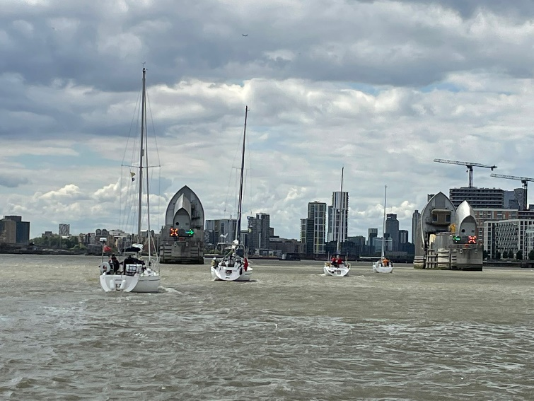
Awards Mark Abbott VR
Photographic Award
Nigel or Helen Baker

Slide 12
Awards Mark Abbott VR
Eberhardt Cup
Awarded for the biggest contribution to hosting.
John, Liz Gee (impromptu drinks and nibbles at Woodbridge)
Endeavour Award
Awarded for outstanding endeavour.
Sue, Paul Armstrong? (Without doubt a steep learning curve)

Slide 13
Awards Mark Abbott VR
Commodore’s Cup awarded for the most sea miles achieved on Club events.
1st Place Nigel Baker Malahi 497M
2nd Place Garry Stratton Ceilidh 392M
3rd Place Peter Morley Aquila 390M

Slide 14
Constitution Mark Abbott VR
History- Up until 4 year ago our only governing document was the constitution. In the last few years we have had to produce policy documents on GDRP, Children, IT and Crew pool. We also needed a document that could capture our intentions and direction as a club.
Code of Practice, This document demonstrated the intent as to how the club should be run. Unlike the Constitution which is not based on intent but hard and fast statements. Quite rightly this is why we can only change the Constitution at an AGM or EGM.
We have an opportunity, when the Constitution was written all the Club process’ were described which means there are some grey or aspirational point in it. What we put to you is a Constitution which is streamlined to include only the RED LINE items which we will not cross. We have placed any grey, aspirational or items we know we can’t achieve all of the time in the Code of Practice. This allows us to overlook them as a committee, if and only if, the need arises, without seeking an AGM EGM.
Nothing is lost!

Slide 15
Shotley Point Yacht Club
AGENDA
1. Apologies for absence. (BdB)
2. Approval of the minutes. (BdB)
3. Annual report, Commodore. (MA) 3.1. Annual report, Vice Commodore. (SR)
4. Annual report from the Interim accounts and report from Hon Treasurer. To include annual fees. (RW) 4.1. Approval of auditor for the accounts.
5. Membership recruitment and retention. (SB)
6. Award presentations and recognitions. (MA)
7. Changes to Constitution and Code of Practice. (MA)
8. Survey 2022. (GS)
9. Elections. 9.1 Officer step down. 9.2 Officers offering themselves for election or re-election. (BdB) 9.3 Committee Member standing down 9.4 Members offering themselves for election or re-election. (BdB)
10. Program for 2023. (GS) 11.1 Summer Cruise (TB,PM)
11. Any other business. (BdB)
12. Date of next AGM (BdB) .
Grab a Cupper,
Back in 10min

Slide 16
Membership Survey 2022 Garry Stratton
Purpose
To understand how to ensure the Club meets the needs of its members
We asked:
Why did you join Shotley Point Yacht Club?
If you haven't joined any Club activities this year, why?
Does the Club provide what you're looking for?
What is the best thing about the Club?
What is the worst thing about the Club?
What single change would improve your membership experience?
Response:
108 invitations via newsletter (email) 93 read (86%) 55 clicked on the link 35 responses received (32% of invitations, 38% of those who read the newsletter)

Slide 17
Membership Survey 2022 Results
Why did you join?

Slide 18
Membership Survey 2022 Results
Does the Club provide what you’re looking for?

Slide 19
Membership Survey 2022 Results
If you haven’t joined in any activities this year, why?
11 responses

Slide 20
Membership Survey 2022 Results
What is the best thing about the club?
11 responses

Slide 21
Membership Survey 2022 Results
What is the worst thing about the club?
11 responses

Slide 22
Membership Survey 2022 Results
If you could change one thing?
11 responses

Slide 23
Membership Survey 2022 Summary
Key Points
Friendly and engaging club…
…but need to improve the social activities aspect
Many people would like a clubhouse
This would make us a different type of club
Relatively low proportion of members join in events
Due to time pressures – availability or timing
Midweek cruises?
More crewing opportunities
Will look at all suggestions for improvements… watch this space!

Slide 24
Membership Survey 2022 Garry Stratton
Questions?

Slide 25
Election of Committee 2023 Barbara de Bruine
9.1 Officers Stepping down – Vice Commodore Stuart Robinson
9.2 Officer offering themselves for re-election – Commodore Mark Abbott Secretary Barbara de Bruine Treasurer – Richard White
9.3 Committee members stepping down- Garry Stratton, Kevin Gillard
9.4 Committee members offering themselves for re-election – Sheila Barnes, Tim Bultitude, Mark Taylor

Slide 26
Election of Committee 2023 Barbara de Bruine
9.5 Committee members offering themselves for election to Officers – Vice Commodore Garry Stratton
9.6 Members offering themselves for election to Committee – Stuart Robinson, Nigel Baker, Ian Lee
Room for 4 more committee members

Slide 27
Events 2023 Garry Stratton
Full programme planned for 2023
Winter Workshops - practical & theory
Cruising Events - dip in and out
Club Sailing Days
Social Programme
Something for everyone

Slide 28
Events 2023 Garry Stratton
Cruising Events
10 trips (plus two in reserve…)
Old favourites and a new destination on the Thames
France and the Channel Islands
Constrained by location, but we have some great destinations and sailing / cruising / navigation challenges!
Ideas for trips are always welcome
New hosts are very welcome – give it a try!!
There’s always someone to help

Slide 29
Events 2023 Garry Stratton
Club Sailing Days
Saturday 1 April
Saturday 27 May
Saturday 3 June
Sunday 13 August
Saturday 9 September
Saturday 21 October
? November
Short, social trips
Opportunities to cruise in company
Try some navigation techniques
Invite non-boat owners
Experience for Crew Pool

Slide 30
Events 2023 Garry Stratton
Social Events
4 March Meet and Greet
25 March Fitting Out Supper
22 July Home Port Day
23 July RHYC Lunch
28 October Laying up Supper
3 December AGM and Christmas party

Slide 31
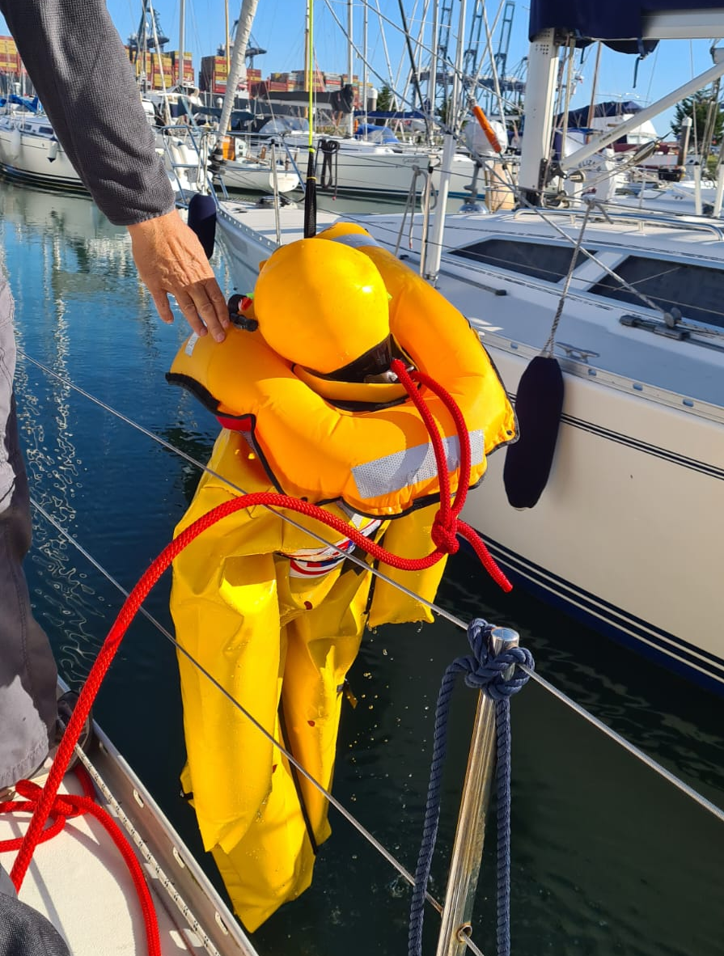
Events 2023 Tim Bultitude
Skills
14 January Meteorology
11 February Splicing Modern Ropes
11 March Passage Plan to Europe, Customs
7 October Basic Boat Electrics
11 November Fighting Fire
2 December Lights, Shapes & Colregs
Winter Workshops
Plus
2 April
13 May
28 May
Man Overboard: practical with Duncan

Slide 32
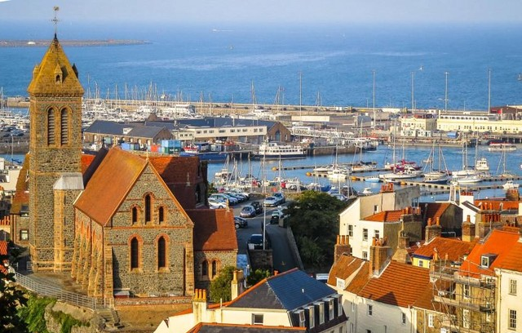
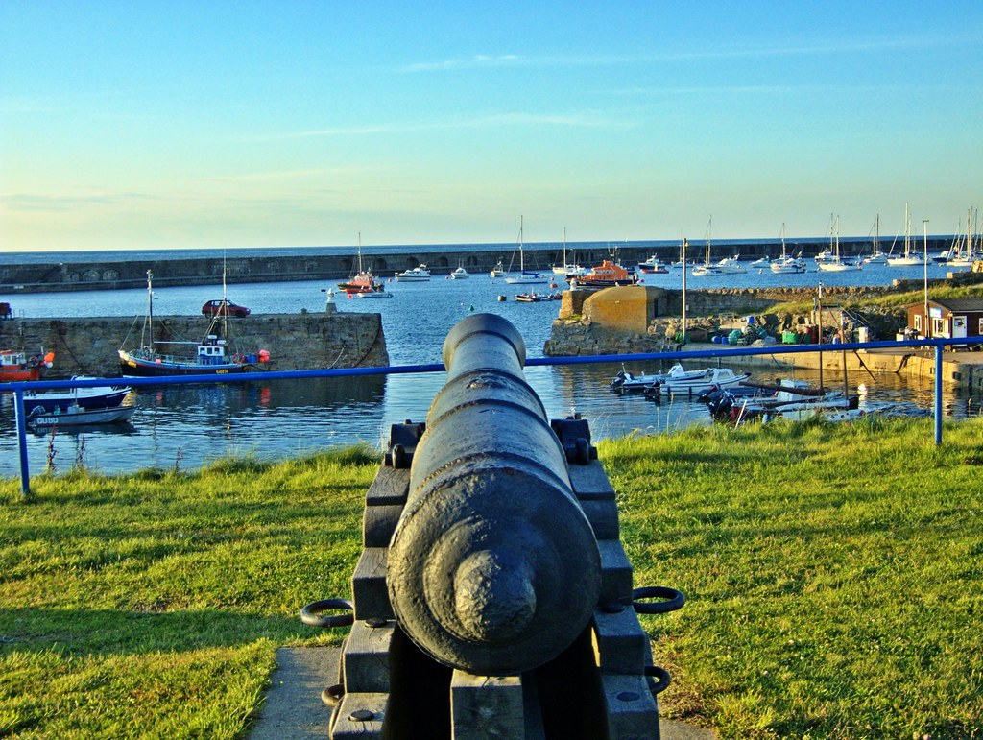
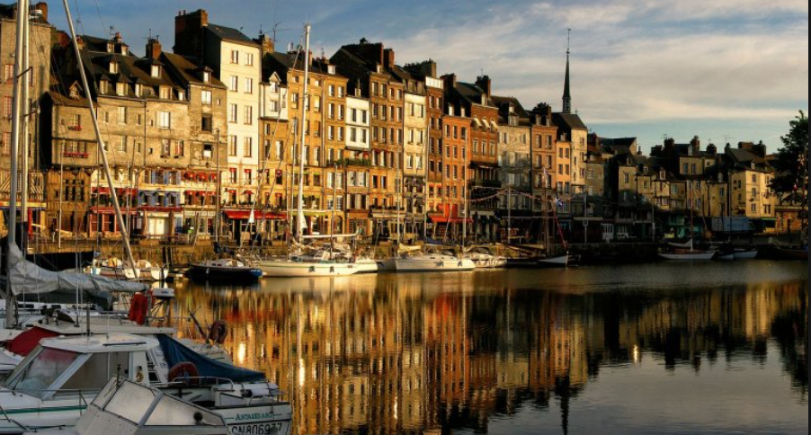
Summer Cruise 2023 Tim Bultitude & Pete Morley
Week 1
Honfleur 1-9th July 2023
Via- Dover, Deppe, Honfleur, Eastbourne & Ramsgate.
Meet your non-sailing partner there or swop crews!
Stepping stone to the Channel Islands
Register your interest and join the WhatsApp group- Honfleur
Week 2
Channel Islands 7th-15th July 2023
Honfleur, Cherbourg, Guernsey, Alderney, Portsmouth, Eastbourne & Ramsgate.
2 day stop over in Guernsey.
1 day Stop in Alderney.

Slide 33
Summer Cruise 2023 Tim Bultitude & Pete Morley
Week 1
Week 2
Return

Slide 34
AGM 2022 Mark Abbott VR
AOB
Questions?
Next AGM Saturday 9th December 2023

Slide 35
Shotley Point Yacht Club
AGENDA
1. Apologies for absence. (BdB)
2. Approval of the minutes. (BdB)
3. Annual report, Commodore. (MA) 3.1. Annual report, Vice Commodore. (SR)
4. Annual report from the Interim accounts and report from Hon Treasurer. To include annual fees. (RW) 4.1. Approval of auditor for the accounts.
5. Membership recruitment and retention. (SB)
6. Award presentations and recognitions. (MA)
7. Changes to Constitution and Code of Practice. (MA)
8. Survey 2022. (GS)
9. Elections. 9.1 Officer step down. 9.2 Officers offering themselves for election or re-election. (BdB) 9.3 Committee Member standing down 9.4 Members offering themselves for election or re-election. (BdB)
10. Hand over to new Commodore
11. Program for 2023. (GS) 11.1 Summer Cruise (TB,PM)
12. Any other business. (BdB)
13. Date of next AGM (BdB) .
Thank You all for your continued Support

