Slide 1
Shotley Point Yacht Club
AGENDA
1. Apologies for absence. (BdB)
2. Approval of the minutes. (BdB)
3. Annual report, Commodore. (MA) 4. Annual report, Vice Commodore. (PC)
5. Annual report from the Interim accounts and report from Hon Treasurer. (RW) 6. Approval of auditor for the accounts.
7. Membership recruitment and retention. (SB)
8. Award presentations and recognitions. (MA)
9.1 Officer step down. 9.2 Officers offering themselves for election or re-election. (BdB)
9.3 Committee Member standing down 9.4 Members offering themselves for election or re-election. (BdB)
10. Survey 2021. (GS)
11. Event Hosting. (BS)
12. Program for 2022. (SR)
13.One membership for all paying members of £52. (RW, Proposed, SR, Seconded)
14. Any other business. (BdB)
15. Date of next AGM- Sat 03 December 2022.

Slide 2
Commodores Report Mark Abbott RV
Membership is stable
41 Events with over 946M of cruising available.
10 Skippers with 32 Crew Pool over 5 Cruising Days.
Introduction of Skipper Skills
10 Winter Workshops
New Website, and introduction of WhatsApp. Facebook outward facing. 3 editions of Crow’s Nest.
Covid allowed us to improve our process’
3 Year Plan
Our Committee keep the cogs moving

Slide 3
Vice-Commodores Report Peter Cox
This was sent to all members.
Any questions?

Slide 4
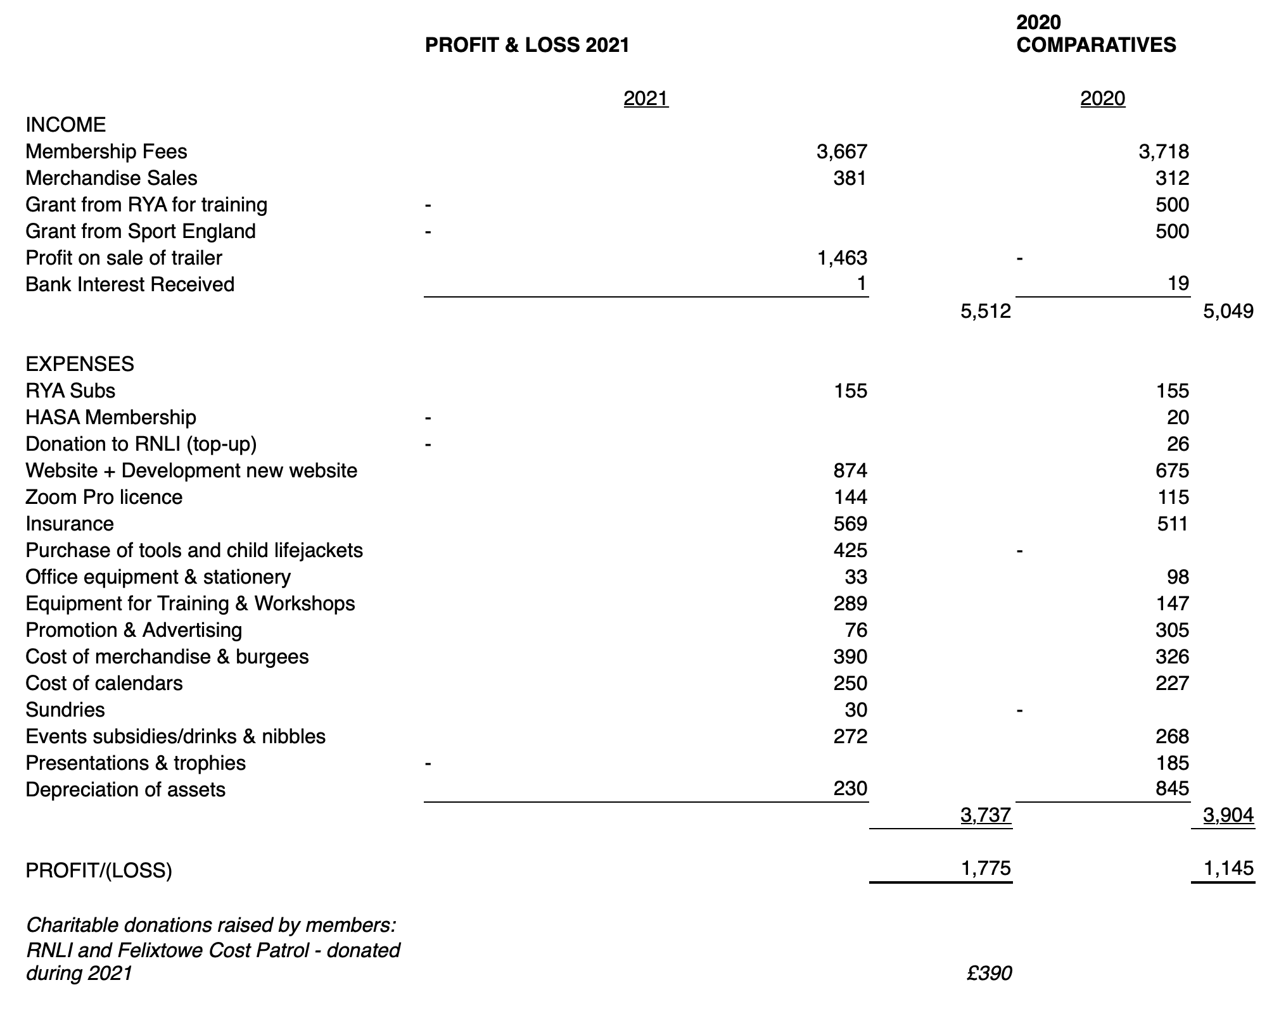
Hon Treasurers Richard White

Slide 5
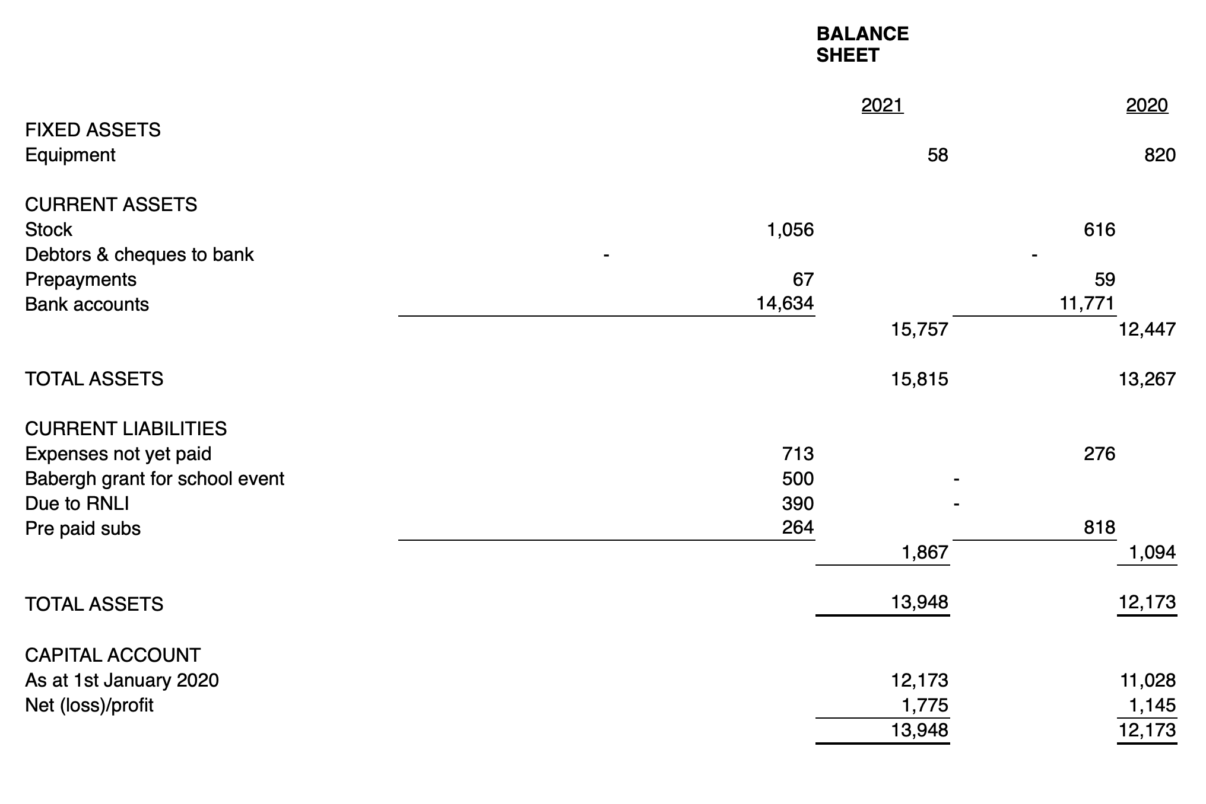
Hon Treasurers Richard White

Slide 6
Membership Secretary Sheila Barnes

Slide 7
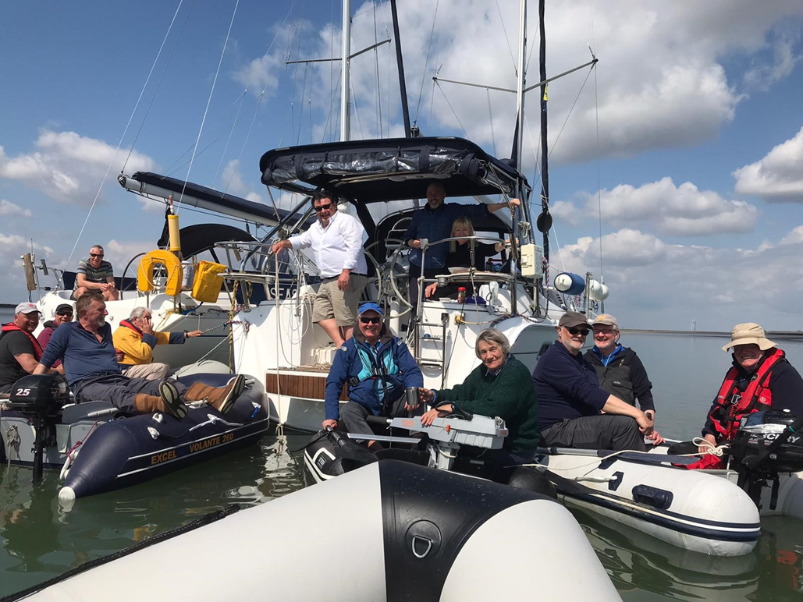
Awards Mark Abbott RV
Photographic Award
Beth Joyce

Slide 8
Awards Mark Abbott RV
Eberhardt Cup
awarded for the biggest contribution to hosting.
Peter Cox
Phil Renno Award
awarded for outstanding endeavour.
Ian Parrish

Slide 9
Awards Mark Abbott RV
Commodore’s Cup awarded for the most sea miles achieved on Club events.
1st Place Garry Stratton Ceilidh 460.4
2nd Place Ian Lee Kazarka 343.8M
3rd Place Steve Joyce Blue Lion 298.2M

Slide 10
Shotley Point Yacht Club
AGENDA
1. Apologies for absence. (BdB)
2. Approval of the minutes. (BdB)
3. Annual report, Commodore. (MA) 4. Annual report, Vice Commodore. (PC)
5. Annual report from the Interim accounts and report from Hon Treasurer. (RW) 6. Approval of auditor for the accounts.
7. Membership recruitment and retention. (SB)
8. Award presentations and recognitions. (MA)
9.1 Officer step down. 9.2 Officers offering themselves for election or re-election. (BdB)
9.3 Committee Member standing down 9.4 Members offering themselves for election or re-election. (BdB)
10. Survey 2021. (GS)
11. Event Hosting. (BS)
12. Program for 2022. (SR)
13.One membership for all paying members of £52. (RW, Proposed, SR, Seconded)
14. Any other business. (BdB)
15. Date of next AGM- Sat 03 December 2022.

Slide 11
Membership Survey 2021 Garry Stratton
Responses:
140 invitations via newsletter (email) 103 read (74%) 77 clicked on the link 40 responses received (29% of invitations, 39% of those who read the newsletter)
What type of member are you?
Boat Owner
Non-Boat owner
22.5%
77.5%

Slide 12
Membership Survey 2021 Summary
Preferences
Midweek cruises: 58% could participate; take-up has been low
Most enjoy: Cruises (85%) and Cruising Days (68%)
Interested: All Events (70%); 2 people not interested in any club events…
Programme: 58% not too busy; 40% not sure
Children’s Events: 32% yes, 20% no, 48% not sure
Training: 53% like Winter Workshops, 40% not tried
Crew Pool: 38% have used Crew Pool; 23% cruise with family and friends

Slide 13
Membership Survey 2021 Summary
Communication:
Website (68%), Crow’s Nest (83%), WhatsApp (63%) “Good”
13 / 28 comments “Good”
Social media communities and groups not really used by the club
Some people not aware of Facebook and WhatsApp groups
More face-to-face communications wanted

Slide 14
Membership Survey 2021 Communication
I think that a lot more face to face coms would be appreciated maybe a few more social events would provide the opportunities.
Do you have any comments about Club communications?
28 responses
Crow's Nest is more than "Good" - it's excellent ! I believe it should be visible to the public.
I would really like a more member activity and a community based Facebook and WhatsApp group (like Shaun's Shorts). Its not really used by members.
Crows nest is rather too wordy.
…socialising is paramount to a club. Providing this is key SPYC don't do this well, on board nibbles is not enough and too late in the weekend. Pub meet, Chat, will improve attendance on events.
Too much chit chat on what’s app
I get everything twice
Emails seem clear, relevant and timely. Facebook posts seem infrequent. WhatsApp for events seem to work but sometimes threads get a bit jumbled leading to some confusion - at least in my head.
Too many news letters sometimes.
Wasn't aware of FB/WA groups
I didn't know there was a WhatsApp group.
Like the booking on events pages. Like the group chats on events through WhatsApp. Like the email updates and upcoming events info. Comms just about right for me
Only that we need a channel to communicate on when on trips.

Slide 15
Membership Survey 2021 Summary
Future
88% feel their membership is value for money
43% agree with one level of membership; 45% not sure
66% of CP respondents would be prepared to pay the same as boat owners; 33% would not
Why not considered joining the committee? Many reasons; time (37% of non-committee members responding)
Look at the option to merge with Shotley Sailing Club? 87.5% “Yes”; 12.5% “No”

Slide 16
Membership Survey 2021 The Future
If you could change one thing about SPYC, what would it be?
26 responses
I am happy with the club as it is (x5), relaxed atmosphere, casual but organised.
I would like to have somewhere to meet and socialise (x3).
On the marina (not The Shipwreck).
Outside toilets is not it.
Ability to socialise on an informal basis
Have a club house (x2)
Too new to be able to comment, but I really like the friendly club.
Better online community
Geared mostly towards retired generation, who have plenty of time available. Cruising events do not take into account school holidays. When cruising events occupy school days, it is simply not possible to join in.
Specific social (meet & greet) event for new members
I understand the need to have the survey in box ticking form but I could add lots more to the answers to give more than yes/ no answers.... and I would prefer that.... Thanks to all for this year and all the work put in by all concerned
More ad hoc onshore social evenings would be more achievable if we join Shotley sailing club
I agree that members should always look at ways to improve the club, but feel any proposed changes should be carefully considered from all sides.
Join up with the sailing club and apply for royal status, considering our location.
Better quality burgees - happy to pay more if they didn't shred!!
Join the sailing club. The club has a better social gathering point than The Shipwreck (this is my opinion only)
Have a club boat
Get more members to volunteer
One level of membership

Slide 17
Membership Survey 2021 Garry Stratton
Questions?

Slide 18
Membership Survey 2021 Detail

Slide 19
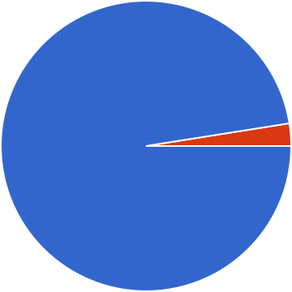
Membership Survey 2021 Responses
What type of boat do you cruise in
40 responses
Sailboat Motorboat
97.5%
What size of boat do you cruise/mostly cruise in?
40 responses
<20'
20'-30'
31'-40'
>40'
15%
72.5%
12.5%

Slide 20
Membership Survey 2021* Preferences
Who do you mostly cruise with?
40 responses
Family Friends
Crew Pool Alone
35%
15%
45%
How far would you be prepared to cruise in one day?
40 responses
<10M 10-19M
20-29M
30-39M
40M>
42.5%
25%
17.5%
15%

Slide 21
Membership Survey 2021 Preferences
If the Club put on midweek cruising, would you be able to participate?
40 responses
Yes No
Sometimes
10%
32.5%
57.5%
Can you only do weekend cruises?
40 responses
Yes No
75%
25%

Slide 22
Membership Survey 2021 Preferences
What events do you most enjoy
40 responses
Weekend Cruising
34 (85%)
Cruising Days
27 (67.5%)
Land Based Training
16 (40%)
Practical Training
17 (42.5%)
Social Events
21 (52.5%)
I'm not interested in any
Club Events
2 (5%)
What events do NOT interest you?
40 responses
0
10
20
30
40
Weekend Cruises
1 (2.5%)
Cruising Days
3 (7.5%)
Land Based Training
7 (17.5%)
Practical Training
4 (10%)
Social Events
2 (5%)
I'm Interested in all Events
28 (70%)
0
10
20
30

Slide 23
Membership Survey 2021 Preferences
Is the programme of events too busy?
40 responses
Yes No
Not Sure
40%
57.5%
Do you think we should organise special events for children?
40 responses
Yes No
Not Sure
47.5%
20%
32.5%

Slide 24
Membership Survey 2021* Preferences
Do you like land-based social events?
40 responses
Yes No
10%
90%

Slide 25
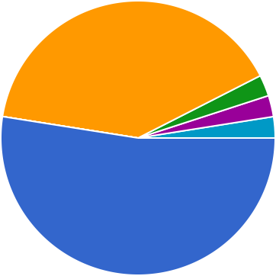
Membership Survey 2021* Preferences
Do you like the skills refresher (Winter Workshop) events?
40 responses
Yes No
I have never used Winter Workshops
Maybe
just trying one for first time
Yes, when able to attend - not keen on zoom
40%
52.5%
Think about training events.
40 responses
To many Enough To Few
10%
90%

Slide 26
Membership Survey 2021 Preferences
Skipper Skills sessions were not well attended: why do you think they were not attractive to members?
31 responses
Too many other events / not enough time (7)
Not of interest (4)
Lack of awareness / marketing (8)
"We [probably think we] know it!“ (4)
New member / other (8)

Slide 27
Membership Survey 2021 Preferences
If you haven't used Crew Pool was it because?
40 responses
I don't want strangers on my… I cruise solo
I cruise with family and friend… I don't like Crew Pool.
I use Crew Pool I am crew pool
We do not need crew, and we… Have open mind
37.5%
22.5%

Slide 28
Membership Survey 2021 Communication
What is your opinion of the website?
40 responses
Good Ok
Neither good or bad Not great
Bad
I have never used it
27.5%
67.5%
What is your opinion of the Crow's Nest?
40 responses
Good Ok
Neither good or bad Not great
Bad
I have not seen it
82.5%

Slide 29
Membership Survey 2021 Communication
What is your opinion of the Facebook page?
40 responses
Good Ok
Neither good or bad Not great
Bad
I have not seen it
42.5%
15%
17.5%
20%
What is your opinion of the WhatApp pages?
40 responses
Good Ok
Neither good or bad Not great
Bad
I have not used them
15%
15%
62.5%

Slide 30
Membership Survey 2021 The Future
Do you feel you get value for money from your membership of SPYC?
40 responses
Yes No
I'm not sure
10%
87.5%
Should there be just one level of membership?
40 responses
Yes No
I'm not sure
45%
12.5%
42.5%

Slide 31
Membership Survey 2021 The Future
If Crew Pool member, would you be prepared to pay the same as boat- owners?
40 responses
Yes No
77.5%
I'm a boat owner
15%
Why have you not considered being a committee member?
40 responses
No time
I don't feel I could add much I'm not a committee person I am a Committee Member
Already on the come of anoth… New member
I am a new member
I have been in the past
25%
27.5%

Slide 32
Membership Survey 2021 The Future
The committee are always looking to improve the Club for members. One such option is to merge with Shotley Sailing Club. We will be guided by you, the members, who will have the final say. At this early stage, do you think this is something the committee should look at in greater depth?
40 responses
Yes, I would like the committee to find out more.
No, I believe the committee should not find out more.
12.5%
87.5%

Slide 33
Hosting Sheila Barnes
Some questions asked
Do I need any special skills?
Does it take up a lot of time to organise?
Do I have to book marinas, check tides etc.?
Who sends the email newsletter and can I design my own if I want to?
How do I get the bookings information?
I don’t have a boat/ I have a very small boat – how can I set up drinks and nibbles?
Drinks and nibbles – What do I get, how much can I spend, and how does the club refund me?
Do I have to organise an evening meal for everyone?
Questions?

Slide 34
Events 2022 Stuart Robinson
Full programme planned for 2022
Winter Workshops - practical & theory
Cruising Events - dip in and out
Club Sailing Days
Social Programme

Slide 35
Events 2022 Stuart Robinson
15 January Practical session - Lifejacket Servicing
16 January Harty Ferry - passage plan
30 January North Sea crossing - passage plan
13 February River Ore and Orford - passage plan
19 February Practical session - Winch Servicing
27 February Tollesbury - passage plan
12 March Practical session - Splicing
13 March Queensborough to Limehouse - passage plan
Winter
Workshops

Slide 36
Events 2022 Stuart Robinson
25 March Night sail to Ipswich
26 - 27 March Shakedown Cruise to Ipswich
14 - 18 April Medway & The Swale
14 - 15 April - Chatham
16 - 18 April - Harty Ferry
30 April - 2 May RN&SYC & Blyth
30 April Lowestoft
1 - 2 May Southwold

Slide 37
Events 2022 Stuart Robinson
27 May - 29 May Ore and Alde
27 May - Orford
28 - 29 May – Aldeburgh
2 June - 5 June London & The Thames
2 June - Queenborough
3 - 5 June - Limehouse

Slide 38
Events 2022 Stuart Robinson
23 June - 27 June Deben
23 June - Old Felixstowe
24 June - The Rocks
25 June - Woodbridge
26 June - Waldringfield
27 June - Ramsholt

Slide 39
Events 2022 Stuart Robinson
9 July Home Port Day
10 July RHYC Lunch
29 July - 31 July Walton Backwaters
29 July Hamford Water
30 - 31 July Titchmarsh
13 August - 14 August Burnham on Crouch

Slide 40
Events 2022 Stuart Robinson
20 August - 29 August Blackwater & Colne
20 - 22 August Brightlingsea
23 - 24 August Tollesbury
25 - 26 August West Mersea
27 - 29 August Bradwell
4 September Fishing Competition
17 - 18 September Laying Up weekend

Slide 41
Events 2022 Stuart Robinson
Saturday 9 April
Saturday 14 May
Saturday 11 June
Saturday 16 July
Saturday 3 September
Saturday 8 October
Saturday 5 November
Cruising Days

Slide 42
Events 2022 Stuart Robinson
26 March Fitting Out Supper
22 October Laying up Supper
3 December AGM and Christmas party
Social Events

Slide 43
Events 2022 Stuart Robinson
Questions?

Slide 44
Motion Proposed by Richard White, Seconded by Stuart Robinson
Motion, To have a single pay scale of £52 regardless of being a boat owner or non-boat owner.
This would include non-boat owners enjoying a family membership status.

Slide 45
Shotley Point Yacht Club
AGENDA
1. Apologies for absence. (BdB)
2. Approval of the minutes. (BdB)
3. Annual report, Commodore. (MA) 4. Annual report, Vice Commodore. (PC)
5. Annual report from the Interim accounts and report from Hon Treasurer. (RW) 6. Approval of auditor for the accounts.
7. Membership recruitment and retention. (SB)
8. Award presentations and recognitions. (MA)
9.1 Officer step down. 9.2 Officers offering themselves for election or re-election. (BdB)
9.3 Committee Member standing down 9.4 Members offering themselves for election or re-election. (BdB)
10. Survey 2021. (GS)
11. Event Hosting. (BS)
12. Program for 2022. (SR)
13.One membership for all paying members of £52. (RW, Proposed, SR, Seconded)
14. Any other business. (BdB)
15. Date of next AGM- Sat 03 December 2022.

Slide 46
Shotley Point Yacht Club
AGENDA
1. Apologies for absence. (BdB)
2. Approval of the minutes. (BdB)
3. Annual report, Commodore. (MA) 4. Annual report, Vice Commodore. (PC)
5. Annual report from the Interim accounts and report from Hon Treasurer. (RW) 6. Approval of auditor for the accounts.
7. Membership recruitment and retention. (SB)
8. Award presentations and recognitions. (MA)
9.1 Officer step down. 9.2 Officers offering themselves for election or re-election. (BdB)
9.3 Committee Member standing down 9.4 Members offering themselves for election or re-election. (BdB)
10. Survey 2021. (GS)
11. Event Hosting. (BS)
12. Program for 2021. (SR)
13.One membership for all paying members of £52. (RW, Proposed, SR, Seconded)
14. Any other business. (BdB)
15. Date of next AGM- Sat 03 December 2022.
Thank You all for your continued Support

